Slide 1
Problems on Operator Precedence

Slide 2
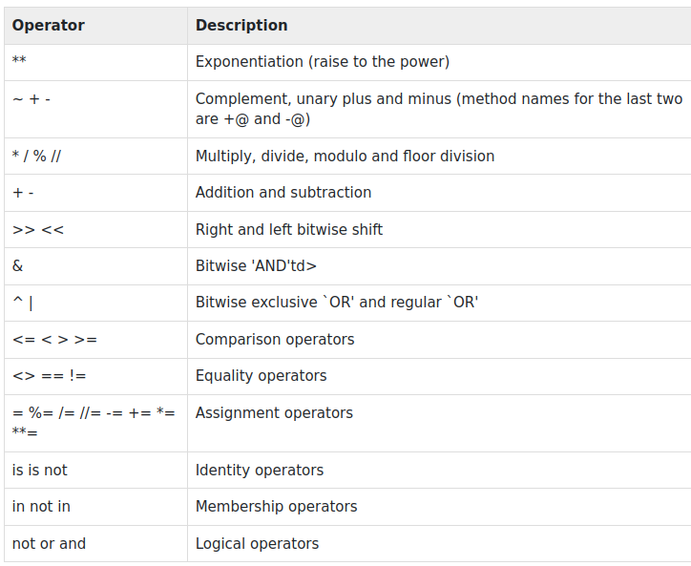
Operator Precedence

Slide 3
Problem 1
Solve 25 + 10 * 20

Slide 4
Solution 1
25 + 10 * 20 is calculated as 25 + (10 * 20)
and not as (25 + 10) * 20
>>> 25 + 10 * 20
225

Slide 5
Problem 2
What will be output of:
print(3*1**3)

Slide 6
Solution 2
3*1**3 is equivalent to: 3 * (1**3)
(base) ashish@ashish:~$ python
Python 3.9.13 (main, Aug 25 2022, 23:26:10)
[GCC 11.2.0] :: Anaconda, Inc. on linux
Type "help", "copyright", "credits" or "license" for more information.
>>> 3*1**3
3

Slide 7
Problem 3
# Precedence of 'or' & 'and'
name = "Alex"
age = 0
if ( name == "Alex" or name == "John" ) and age >= 2 :
print("Hello! Welcome.")
else :
print("Good Bye!!")

Slide 8
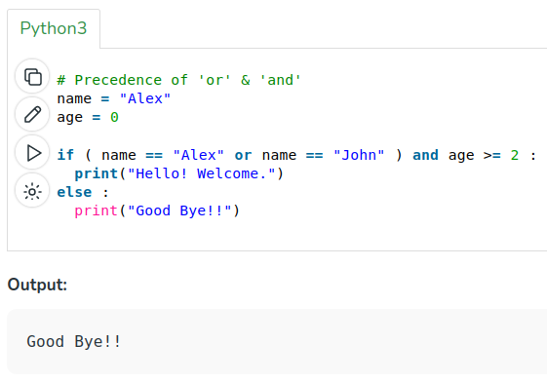
Solution 3

Slide 9
Problem 4
# Precedence of 'or' & 'and'
name = "Alex"
age = 0
if name == "Alex" or name == "John" and age >= 2 :
print("Hello! Welcome.")
else :
print("Good Bye!!")

Slide 10
Solution 4 (Part 1)
Condition: name == "Alex" or name == "John" and age >= 2
It is equivalent to:
name == "Alex" or (name == "John" and age >= 2)
For:
name = "Alex"
age = 0
What will it print(): True or False?

Slide 11
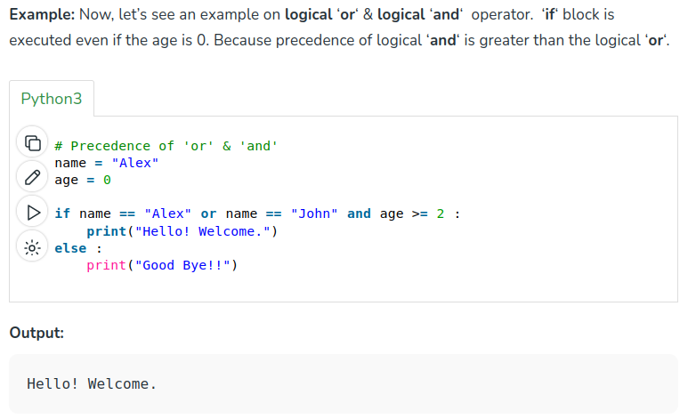
Solution 4 (Part 2)

Slide 12
Operator Associativity
Operator Associativity: If an expression contains two or more operators with the same precedence then Operator Associativity is used to determine. It can either be Left to Right or from Right to Left.
Example: ‘*’ and ‘/’ have the same precedence and their associativity is Left to Right, so the expression “100 / 10 * 10” is treated as “(100 / 10) * 10”.

Slide 13
Problem 5
print(100 / 10 * 10)
print(5 - 2 + 3)
print(2 ** 3 ** 2)

Slide 14
Solution 5
# Left-to-right associativity
# 100 / 10 * 10 is calculated as
# (100 / 10) * 10 and not as 100 / (10 * 10)
print(100 / 10 * 10)
# Left-to-right associativity
# 5 - 2 + 3 is calculated as
# (5 - 2) + 3 and not as 5 - (2 + 3)
print(5 - 2 + 3)
# right-to-left associativity
# 2 ** 3 ** 2 is calculated as
# 2 ** (3 ** 2) and not as (2 ** 3) ** 2
print(2 ** 3 ** 2)
>>> 2 ** 3 ** 2
512

Slide 15
Problem 6
print(10 + 10 / 10 - 10 * 10)
print(100 + 200 / 10 - 3 * 10)

Slide 16
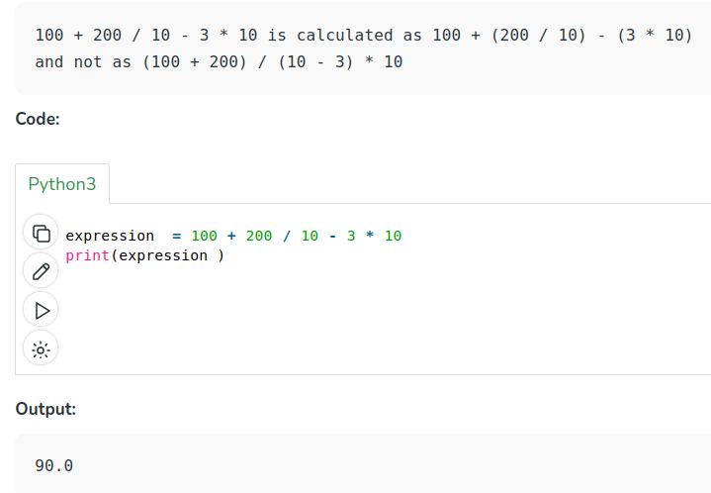
Solution 6
>>> print(10 + 10 / 10 - 10 * 10)
-89.0

